Slide 1
KTD CLM Spectrometer Tasks
#604 IlluminationSpectrometerDCOffsetCalibration
#623 IlluminationSpectrometerDCOffsetPerformance
Tina
wk1840

Slide 2
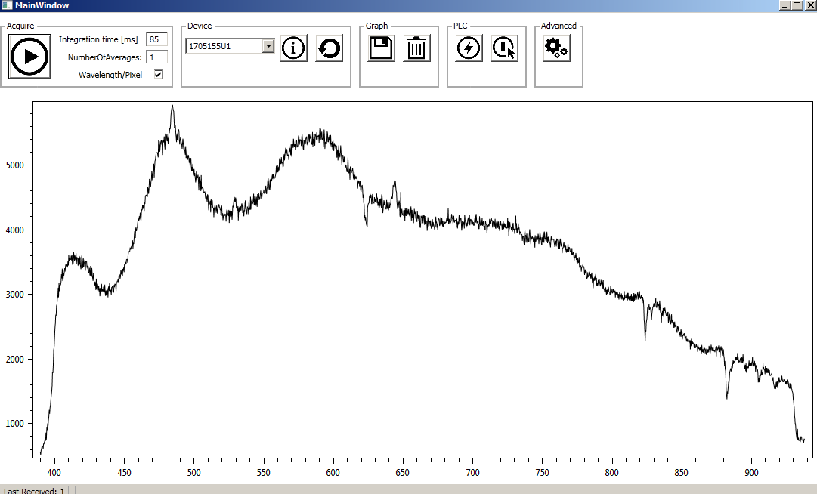



CLM Optical Structure
Task#604: Spectrometer DC Offset calibration
Main path
Spectrometer path
LPPS
Internal Spectrometer
Calibration path
H
Cal. source
V
F1
F2
F3
F4
OPTICAL BASE FRAME
Must operate task #605 in advance before starting task #604
L1
L6
L5
≅ 4%
L4
M2
BS2
L2
L3
ND1
5x ND
1x slot
3x spare
M1
≅4%
M3
BS1
LWP
SWP
ND wheel
MOTOR FRAME

Slide 3
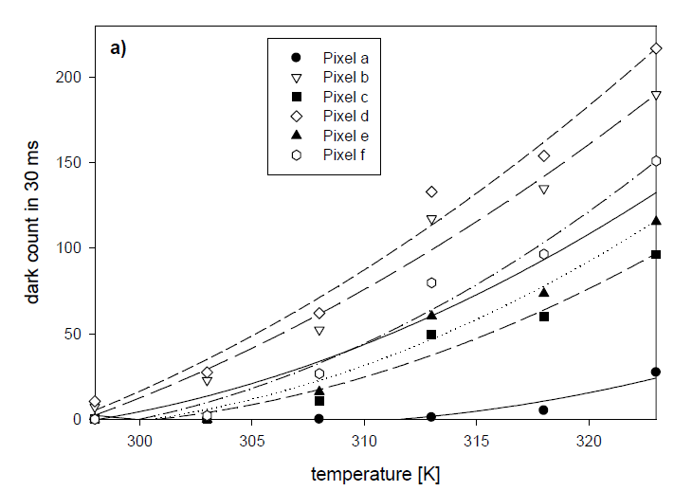
The DC offset origin
The dark current offset has DC and AC components:
DC
Electronic offset such as programmed DC offset
Integrated dark photodiode current.
AC
Dark current shot noise
Read-noise
Position
Integration time
Temperature
Dark current would increase as the temperature increases
Notes:
AC
Shot noise is associated with the random arrival of photons which obeys a square root behavior w.r.t the dark-current),
read-noise comes from the pixel electronics such as in-pixel amplifier and read-out chain.

Slide 4
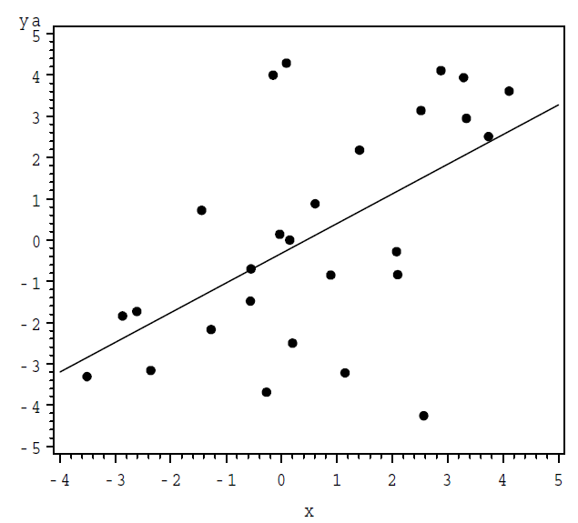

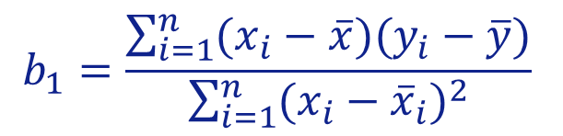
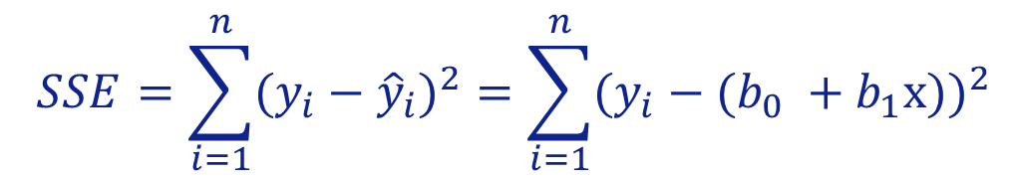

Linear regression
The fitted equation
$${\hat{y}}_{i}= b_{0} +b_{1}x$$
Minimize the error sum of squares (SSE)
$$SSE=\sum_{i=1}^{n}{{(y_{i}−{\hat{y}}_{i})}^{2}}=\sum_{i=1}^{n}{{(y_{i}−(b_{0} +b_{1}x))}^{2}}$$
Through some calculation, obtain the coefficients b0, b1,
$$b_{1}=\frac{\sum_{i=1}^{n}{(x_{i}−\overline{x})(y_{i}−\overline{y})}}{\sum_{i=1}^{n}{{(x_{i}−{\overline{x}}_{i})}^{2}}}$$
$$b_{0}=\overline{y}−b_{1}\overline{x}$$
Notes:
In statistics, linear regression is a linear approach to modelling the relationship between a scalar response (or dependent variable) and one or more independent variables.

Slide 5
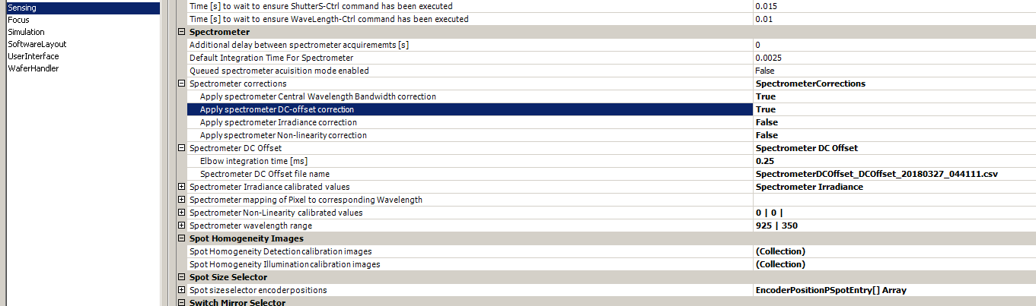
Spectrometer DC Offset Calibration In Task #604
Dark current offset is an offset of the spectrum in dark conditions.
Task 600
WL coarse
Task 605
WL home offset
Task 604
DC offset
Task 623
DC Offset

Slide 6
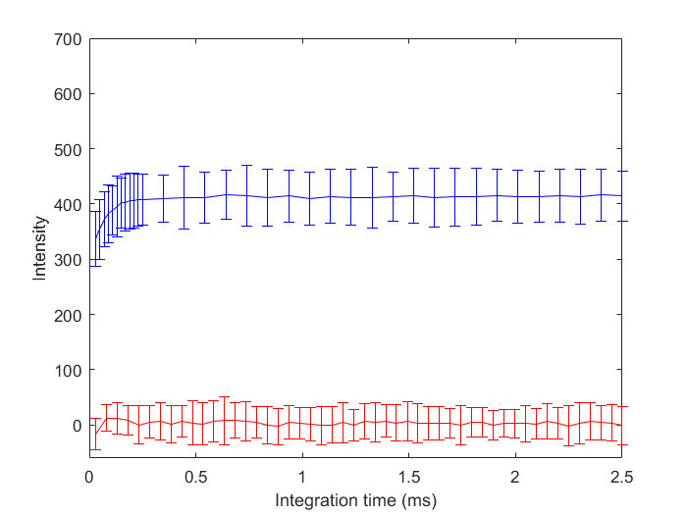



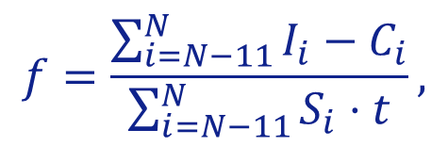


Spectrometer DC Offset Calibration In Task #604
For a specific pixel
100 acquisitions for each integration time
Apply linear regression to obtain the coefficients, C and S, of the fitting line.
Blue→uncorrected
Red→corrected
$$I = C +S τ$$
Calculate the slope scaling factor(using the last 12 dark pixels)
2.7
$$f=\frac{\sum_{i=N−11}^{N}{I_{i}−C_{i}}}{\sum_{i=N−11}^{N}{S_{i}⋅t}},$$
Subtract the fitted spectra from the measured spectra to get the corrected spectra I’
$$τ_{min}$$
$$τ_{elbow}$$
$$τ_{max}$$
$$I^{′}=I−C−f S t.$$

Slide 7
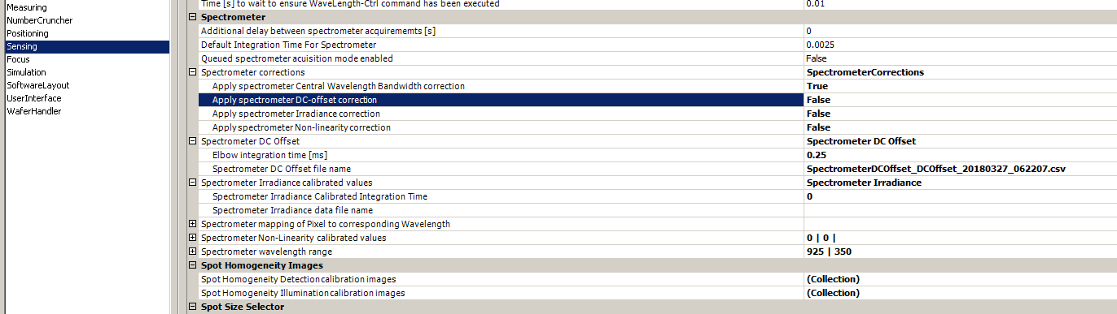
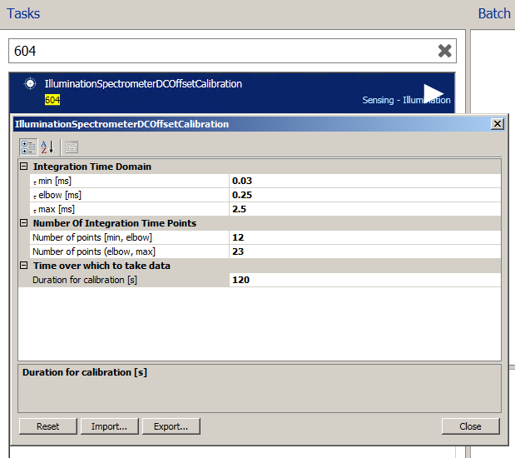
How to perform task #604
1. Equipment constant → Sensing → Spectrometer
Make True
2. Select task #604, check the default input setting and commit ECs if there is no problem
Default input setting
Minimal integration time[ms] | 0.03
Elbow integration time [ms] | 0.25
Maximal integration time [ms] | 2.5
Number of points [min, elbow] | 12
Number of point(elbow, max] | 23
Duration for calibration [s] | 120
Notes:
The temperature fluctuation is of time scale of 120s.

Slide 8
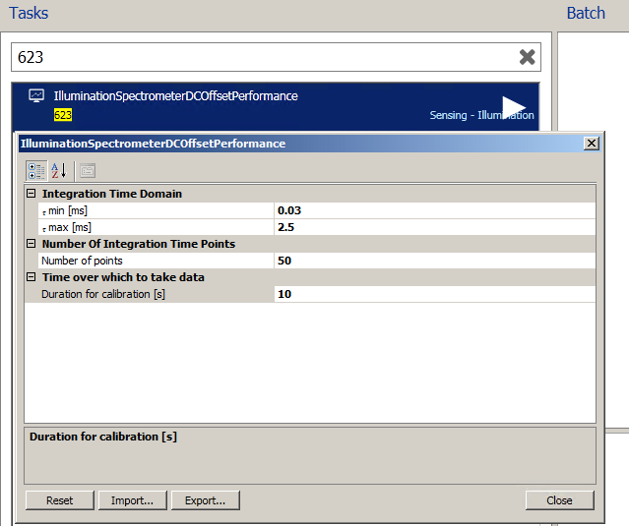
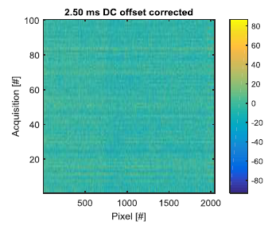

How to verify task #604
1. Select task #623, check input setting, run the task.
Input setting of task #623
Minimal integration time[ms] | 0.03
Maximal integration time [ms] | 2.5
Number of points | 50
Duration for calibration [s] | 10
Uniformity of pixels across each acquisition at given integration time
2. Check the following specification:
< 50.
pixels

Slide 9
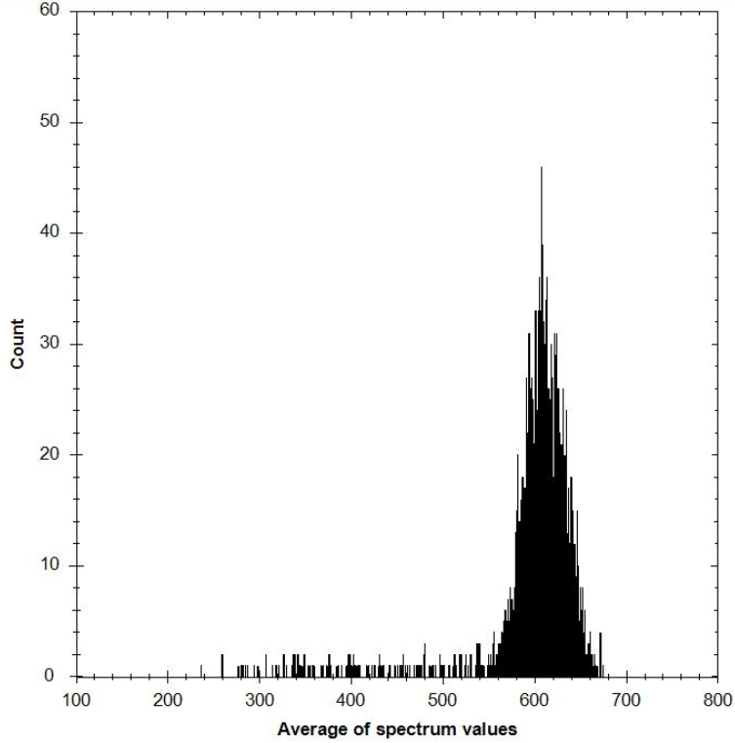
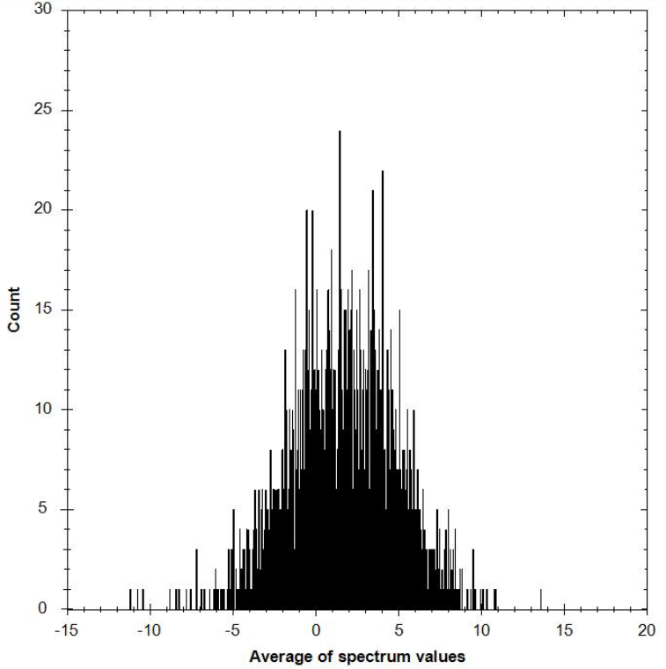
Spectrometer DC Offset Calibration Validation
2.5 ms int. time | Before cal. | After cal.
Reports
Average Spectrum Histogram
 |  | Maximal integration time
Average DCOffset [DN16] | Min | 236.019
 | Mean | 597.893
 | Max | 678.794
Spatial Noise [DN16] |  | 169.838
 |  | Maximal integration time
Average DCOffset [DN16] | Min | -11.227
 | Mean | 1.603
 | Max | 13.624
Spatial Noise [DN16] |  | 9.598
~169
~9
Notes:
Spatial noise is the 3 sigma of all pixels in a specific integration time.

Slide 10
OCAP
SPEC: Maximal offset level noise (3∑) < 50
No OCAP for current version
Potential Problems | Possible Causes | Solutions
Pixel noise too high Frame-to-frame noise too high | Increased temperature Presence of stray light Spectrometer HW issue | Check CL module spectrometer temperature, ensure temp as close to 35̊C. Ensure spectrometer shielded properly from stray light during calibration. Check noise histogram to see if an increase in hot-pixels due to aging might have occurred. In such a case, the spectrometer might be defective.

Slide 11
Q & A

